Slide 1




The Role of Sleep in Adolescent Mental Health and Substance Use
Tuesday, March 27, 2018
Session Hosts:
U.S. Department of Health and Human Services (HHS), Office of the Assistant Secretary for Health’s Region 5 Adolescent Health Network
Ohio Chapter, American Academy of Pediatrics
Ohio Adolescent Health Partnership
Ohio Department of Health
Start School Later, Inc.
Notes:
Standing slide

Slide 2
2018 programming is focused on adolescent mental health and well-being and intersecting health and social issues
To receive updates Subscribe to the Listserv
Send an e-mail to LISTSERV@LIST.NIH.GOV with only this text in the message body:
subscribe REGION-V-ADOLESCENTHEALTHNETWORK “your name”
Contact Lesley.Craig@hhs.gov for more information.

Slide 3
Upcoming April Programs:
Promoting Healthy Relationships and Responding to Adolescent Relationship Abuse, an in-person training session
Thursday, April 12, 2018 • 12:00 p.m. CT • Chicago, IL
Transforming Health Care for Michigan Adolescents: Lessons Learned – Results Achieved!
Thursday, April 26, 2018 • 2:00-3:00 p.m. ET
https://register.gotowebinar.com/register/6597935470303763202
(Questions? Contact Lesley.Craig@hhs.gov)

Slide 4

Led by the HHS Office of Adolescent Health (OAH), TAG is a national call to action to improve adolescent health in the U.S. It aims to reach and engage a wide array of professionals who touch adolescents’ lives, as well as parents and young people themselves. It includes both protective and behavioral risk factors and emphasizes building on young people’s strengths.
TAG highlights Five Essentials for Healthy Adolescents:
Positive connections with supportive people
Safe and secure places to live, learn, and play,
Access to high-quality, teen-friendly health care,
Opportunities for teens to engage as learners, leaders, team members, and workers, and
Coordinated, adolescent- and family-centered services.
http://www.hhs.gov/ash/oah/tag

Slide 5




Resources
                to promote improved sleep health in the U.S., through increased public awareness of the importance of healthy sleep and promotion of treatment and prevention of sleep disorders – includes objective:
                Increase the rate of U.S. teens who get
                sufficient sleep
Established in 2013 by a cooperative agreement between the Centers for Disease Control and Prevention and the American Academy of Sleep Medicine.
http://www.sleepeducation.org/healthysleep
Centers for Disease Control and Prevention
Sleep and Sleep Disorders
http://www.cdc.gov/sleep

Slide 6
DISCLAIMER: The content and views contained in these presentations do not necessarily represent the official policies of the Office of the Assistant Secretary for Health or the U.S. Department of Health and Human Services.

Slide 7
The Role of Sleep in Adolescent Mental Health and Substance Use
Tuesday, March 27, 2018
Hosts and Presenters
Elizabeth Dawson and Kristen Stidham Fluitt, Ohio Chapter, American Academy of Pediatrics
Laura Rooney, Ohio Department of Health
Stacy Simera, Ohio Adolescent Health Partnership & Start School Later, Inc.

Slide 8

Adolescence is a unique developmental period… characterized by distinct and dramatic developmental, physical, social, emotional and intellectual changes. The physical and emotional changes that take place are second only to the changes that take place during infancy.
Ohio Adolescent Health Partnership Strategic Plan “Promoting and Improving the Health of Ohio Adolescents”
Notes:
Because of the rapid development occurring during this period, many physical and mental health conditions, substance use disorders, and health risk behaviors first emerge during adolescence. Yet well-care visit rates decline as children age into adolescence.

Slide 9
Adolescent Well Care:
National Data
Based on billing claims data
48%
Adolescents had a preventive care visit in the
past year
35%
Adolescents received the recommended preventive services
How often do they come to the clinic?
For non-preventive care visits: 1-1.5 times/year
For preventive care visits: 0.15-0.28 times/year
Adams, SH et al, JAMA Peds, 2018, 172(1):43-48
Nordin et al, Annals of Family Medicine, 2010;8(6):511-516
Rand et al, Arch Pediatr Adolesc Med. 2007;161(3):252-259.
Notes:
Recommended preventive care - RAND study from 2007
Preventive vs non-preventive care rates – Nordin 2010 study
Annual preventive care visit & time alone– Irwin Pediatrics study – 2009

Slide 10
Medical and Family History
+
Sports Participation Evaluation
+
Head-to-Toe Exam
+
Confidential Psychosocial Assessment
+
Preventive Health Screening
+
Immunizations
+
Anticipatory Guidance =
Comprehensive & Prevention-Oriented Well Care Visit

Slide 11
Ohio Department of Health Strategic Goals
Maternal & Child Health Block Grant
  Priority Area: Adolescent Health
  Goal: Increase the rate of adolescent well visits and their quality with particular focus on Medicaid eligible youth
  5-year Action Plan

Slide 12




Ohio AAP Adolescent
Programs and Education
HPV Quality Improvement Program

Slide 13


Slide 14



Sleep Committee Chair,
Ohio Adolescent Health Partnership
Health Policy Director,
Ohio Chapter of Start School Later
The role of sleep
in adolescent mental health and substance abuse.
By Stacy Simera, MSSA, LISW-S, SAP
Thank you to the program sponsors:
Notes:
Standing slide

Slide 15

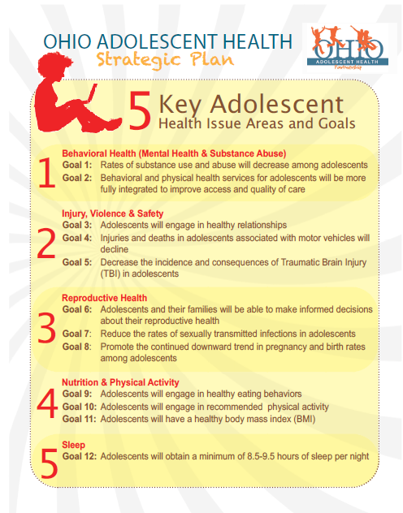
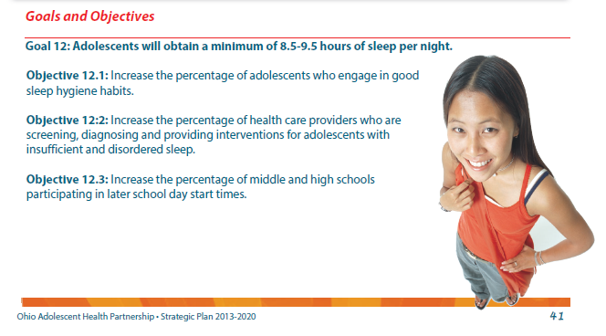
Learn more at: www.OhioAdolescentHealth.org

Slide 16

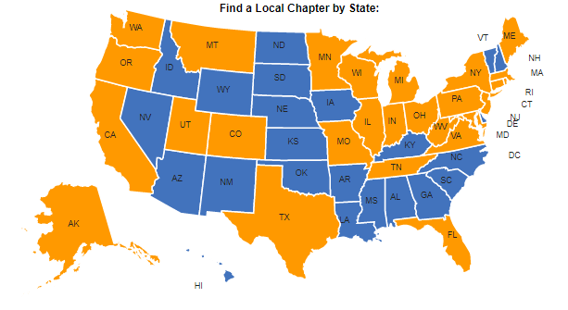
Start School Later is a non-profit coalition of health professionals, sleep scientists, educators, parents, students, and other concerned citizens advocating for school start times compatible with health, safety, education, and equity.
Chapters are currently located in 27 states and D.C.
Learn more at: www.StartSchoolLater.net

Slide 17

Objectives
Understand links between sleep, mental health, and substance abuse.
Recognize adolescent sleep needs and the most common barriers to sufficient teen sleep.
Identify resources available to stakeholders on sleep education and interventions.

Slide 18

How do we know that smoking is bad?

Slide 19
Conclusion:
Smoking is bad.
Correlational Data
Observational Data
Experimental Data
Conclusion:
Teen sleep disruption increases risk of substance use and mental health disorders.

Slide 20
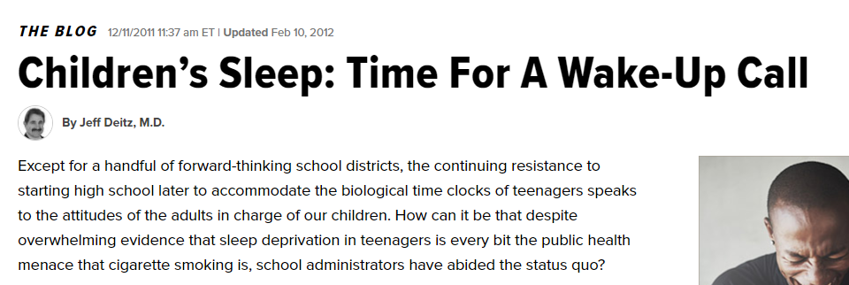

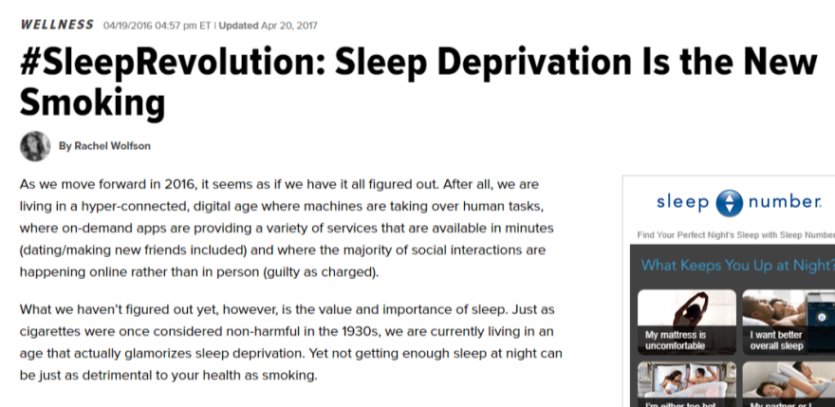
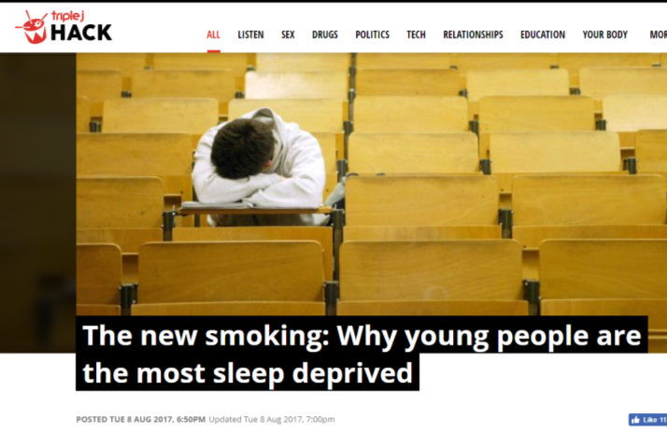


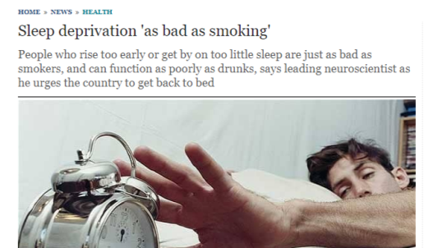

Slide 21
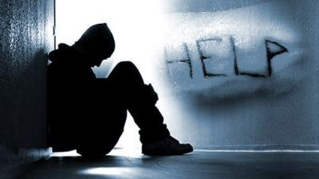
Sleep and Suicide
Over 60 studies have found correlations between chronic insufficient sleep and suicide.
“Unlike other suicide risk factors, sleep complaints
may be particularly amenable to treatment.” (pg 1)
Bernert and Joiner, Sleep disturbances and suicide risk:
A review of the literature. 2007.

Slide 22


“Sleep and Risk-Taking Behavior in Adolescents.”
(O’Brien and Mindell, 2005)
Adolescents with less than 8.5 hrs sleep per night engaged in more:
Violence
Unsafe Behaviors
Drug Use
Sexual Activities

Slide 23

“Relationships between hours of sleep and health-risk behaviors in US adolescent students.”
(McKnight-Eily et al, 2011)
12,154 YRBS survey results from 2007
Insufficient sleep (less than 8 hours) associated w/increased:
Sedentary behavior
Fighting
Cigarette use
Alcohol use
Marijuana use
Sexual Activity
Feeling sad or hopeless
Serious consideration of suicide

Slide 24
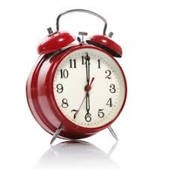
“Sleepless in Fairfax: The Difference One More Hour of Sleep Can Make for Teen Hopelessness, Suicidal Ideation, and Substance Use.”
(Winsler et al, 2015)
Analysis of 2009 YRBS surveys from 27,937 middle and high school students in Fairfax, VA
Controlled for background variables (such as age, ethnicity, etc)
Results…

Slide 25
For every one hour less of sleep a student obtained, the odds of…
… feeling sad and hopeless increased by 38 %
… reporting serious suicidal ideation increased by 42 %
… having already attempted suicide increased by 58%
… using tobacco, alcohol, and/or marijuana increased by 23 %
… using illicit/prescription drugs increased by 37 %
As the lost hours add up, the risks multiply. Example…
… a student who obtains 5 hours of sleep is 2.64 to 3.92 times more likely to be depression and/or suicidal than a student who obtains 8 hours of sleep.

Slide 26
“Trouble sleeping and anxiety/depression in childhood.”
(Johnson, Chilcoat, and Breslau, 2000)
Cross-sectional study of 717 children at ages 6 and 11.
Difficulty sleeping at age six was positively correlated with increased anxiety and depression at age 11.
Association was greater for suburban children than urban.
Factors controlled for include birthweight, gender, and maternal depression.

Slide 27


“The Prospective Association Between Sleep and Initiation of Substance Use in Young Adolescents”
(Miller, Janssen, and Jackson – 2017)
829 middle school students who had NOT used alcohol or marijuana prior to the study
Mean age at beginning of study: 12.6 years old
Followed for 4 years
Results…

Slide 28
Shorter sleep duration was associated with increased alcohol and marijuana use by year 4
For every hour of lost sleep the odds of marijuana use increased by approximately 14%
For every hour of additional sleep the probability of having had a full drink decreased by approx 15%

Slide 29

“Sleep restriction worsens mood and emotion regulation in adolescents.”
(Baum, Beebe, et al 2014)
50 teens in crossover study in summer
1 week sleep restriction – 6.5 hours in bed
1 week healthy sleep duration - 10 hours in bed
Average difference between two weeks – 2.5 hours of sleep
Results of sleep restriction:
  Teens reported increased tension/anxiousness, anger/hostility, confusion, and fatigue
  Parents reported greater oppositionality/irritability and poorer emotional regulation

Slide 30

“Impact of sleep restriction versus idealized sleep on emotional experience, reactivity and regulation in healthy adolescents.”
(Reddy et al, 2017)
42 teens randomized to 4 hours or 9.5 hours of sleep
Measured:
  Self-report of affect and anxiety
  Emotional reactivity to positive, neutral, and negative images
Results – Sleep restriction resulted in:
  Increased anxiety and reduced positive affect
  Greater reactivity to negative images

Slide 31

“The impact of experimental sleep restriction on affective functioning in social and nonsocial contexts among adolescents.”
(McMakin et al, 2016)
Cross-over: two nights of 4 hrs sleep, two nights of 10 hrs sleep/in bed
48 adolescents – self-report and pupil response to positive, neutral, and negative sounds
16 adolescents – reactions to social contexts “primed for peer conflict”
Sleep restriction resulted in:
Increased negative affect as measured by self-report and pupil restriction
Increased negative affective behavior in peer social context as measured by “blinded” coders who assessed video-recordings of the peer discussions

Slide 32

“The impact of experimental sleep restriction on affective functioning in social and nonsocial contexts among adolescents.”
(McMakin et al, 2016)
“Grounded in this evidence base, healthy sleep promotion could be applied as a public health priority (i.e., school start times, sleep health education) or as an early intervention target for high-risk youth during sensitive windows of development, to offset the twofold rise in rates of morbidity and mortality in adolescence.”
Page 1035

Slide 33

“Impact of Delaying School Start Time on Adolescent Sleep, Mood, and Behavior.”
(Owens et al, 2010)
Data from student surveys and school records before and after 30-minute later high school start time change in RI.
Results (201 students):
Average of 45 minutes more sleep
Decreased daytime sleepiness
Decreased fatigue
Reduced health-center visits for fatigue-related visits
Improved attendance
Decreased depressive symptoms

Slide 34

“Longitudinal outcomes of start time delay on sleep, behavior, and achievement in high school.”
(Thatcher and Onyper, 2016)
Data on disciplinary violations for the 2 years before and 2 years after a 45-min delay in high school start times in NY.
Total sleep time did not dramatically change. (20 more min. after first year, stabilized after 2nd year.)
Yet there were measurable differences in behavior…

Slide 35
Before and after 45-min later high school start time change: Total numbers with subcategory examples. (Thacher and Onyper, 2016)
 | 2010-2012 | 2012-2014
Reportable Offenses – Total: | 62 | 44
Assault with injury or threat of injury | 6 | 4
Physical altercation without injury | 26 | 16
Use, possession, or sale of drugs | 17 | 11
Non-Reportable Offenses - Total: | 3,159 | 1,447
Alcohol | 5 | 0
Other Drugs | 5 | 4
Tobacco | 6 | 2
Fighting | 26 | 9
Disorderly conduct | 302 | 131
Teacher Time Out | 456 | 45

Slide 36
Multi-site study: Impacts of later school start times.
(Wahlstrom et al, 2014)
School District: | Start Time Change:
Mahtomedi, MN | 7:30am → 8:00am
South Washington, MN | 7:35am → 8:35am
Boulder, CO | 7:30am → 8:00 am (9am on Wed)
Fairview, CO | 7:35am → 8:05am
Jackson Hole, WY | 7:35am → 8:55am
St. Louis, MN | 7:50am → to 8:20am
Later start times increased the percentage of students who reported at least 8 hours of sleep.
Grades improved in 5 of 6 schools.
Students who obtained 8 or more hours of sleep reported fewer symptoms of depression and less substance use.
Car crashes reduced by 65% in Mahtomedi and 70% in Jackson Hole.

Slide 37
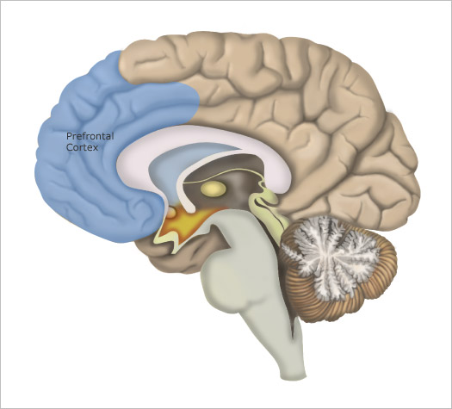
Sleep loss reduces metabolic activity to the pre-frontal region of the brain

Slide 38
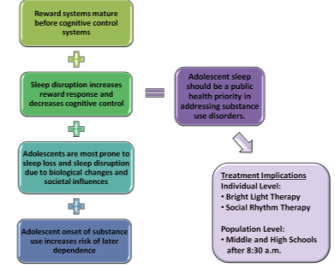
“Impact of sleep and circadian rhythms on addiction vulnerability in adolescents.”
(Logan et al, 2018 – in press – Biological Psychiatry)
Research overview with 150 citations
Brain development
Experimental studies
Population studies
Evidence from animal models

Slide 39
Reward systems mature before cognitive control systems
Sleep disruption increases reward response and decreases cognitive control
Adolescents are most prone to sleep loss and sleep disruption due to biological changes and societal influences
Adolescent onset of substance use increases risk of later dependence
Adolescent sleep should be a public health priority in addressing substance use disorders.
Treatment Implications Individual Level:
Bright Light Therapy
Social Rhythm Therapy
Population Level:
Middle and High Schools
after 8:30 a.m.

Slide 40
Adolescent Sleep Needs (12-25)
8.5 – 9.5 hours
Ideal
12 11 10 9 8 7 6
(Source: 2007 – 2015 YRBS)

Slide 41
Adolescent Sleep Needs (12-25)
Percentage of high school students w/ 9 hrs sleep?
Ideal
12 11 10 9 8 7 6
(Source: 2007 – 2015 YRBS)

Slide 42
Adolescent Sleep Needs (12-25)
The average adolescent sleeps
6.75 hrs on school nights.
Obtained
Ideal
12 11 10 9 8 7 6
(Source: 2007 – 2015 YRBS)

Slide 43
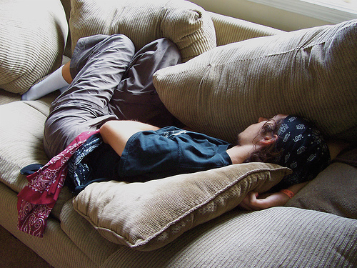
Weekend Catch-Up
Sleeping more than two hours extra on weekends produces a ‘jet lag’ effect –
“similar to flying to China and back every weekend”
(Bergin and Bergin, 2009)

Slide 44
Reporting flaw:
Average sleep needed for adolescents: 9 hours
Most public reports focus on 8 hours of sleep
Statistics
Ideal
12 11 10 9 8 7 6

Slide 45
Racial Differences in Teen Sleep:
(Sources: 2013-2016 YRBS and Minnesota SSR)
High school students who obtain 8 or more hours of sleep on school nights.
 | White | Black
Illinois | 25.7% | 18.4%
Indiana | 22.6% | 17.4%
Michigan | 21.8% | 15.2%
Minnesota (11th graders) | 24% | 21%
Ohio | 26.9% | 22.9%
Wisconsin | 36.6% | 29.1%

Slide 46
Gender Differences in Teen Sleep:
(Sources: 2013 – 2016 YRBS and Minnesota SSR)
High school students who obtain 8 or more hours of sleep on school nights.
 | Male | Female
Illinois | 25.4% | 21.6%
Indiana | 23.5% | 19.2%
Michigan | 22% | 18.5%
Minnesota (11th graders) | 25.8% | 20.1%
Ohio | 29.4% | 22.9%
Wisconsin | 38.1% | 31.7%

Slide 47



Barriers to Sleep for Adolescents
Lack of Awareness
Evening Stimulation
Early Wake Times

Slide 48
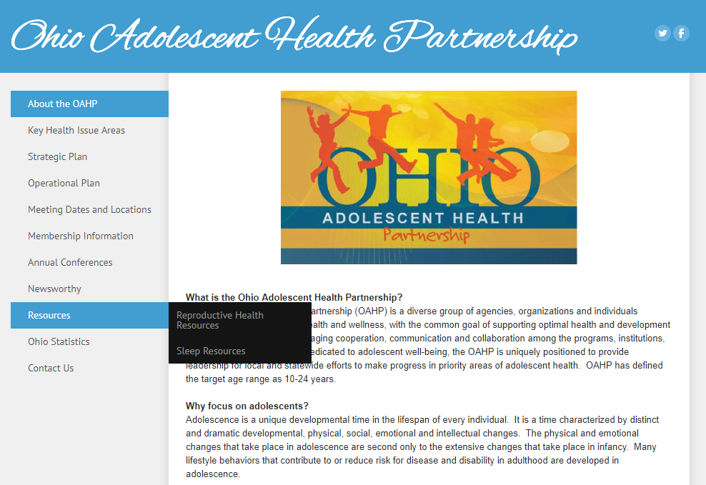
www.OhioAdolescentHealth.org

Slide 49
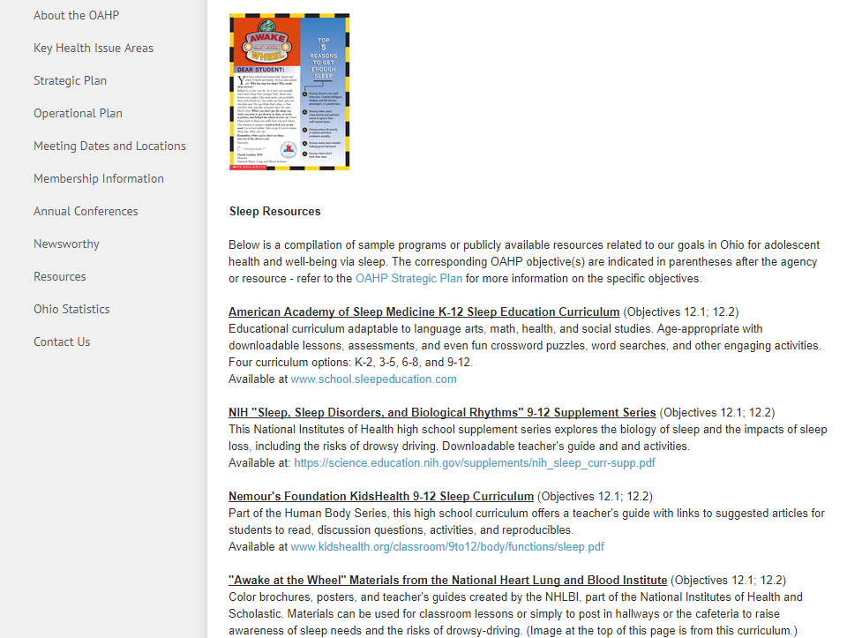
This PowerPoint will be available on
the OAHP website…
www.OhioAdolescentHealth.org

Slide 50
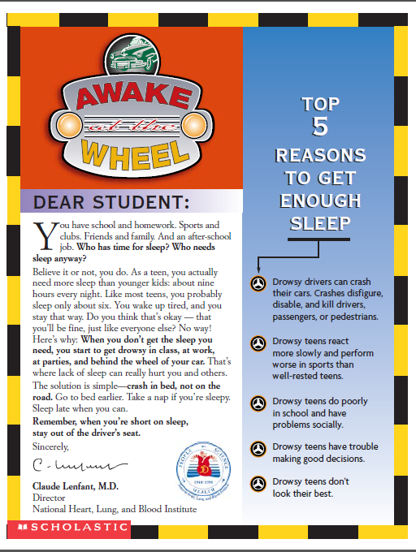
Free Posters for Schools
http://www.nhlbi.nih.gov/health/resources/sleep/aaw-awake

Slide 51

NIH - NHLBI Grades 9-12 Curriculum
https://science.education.nih.gov/customers/HSSleep.html

Slide 52
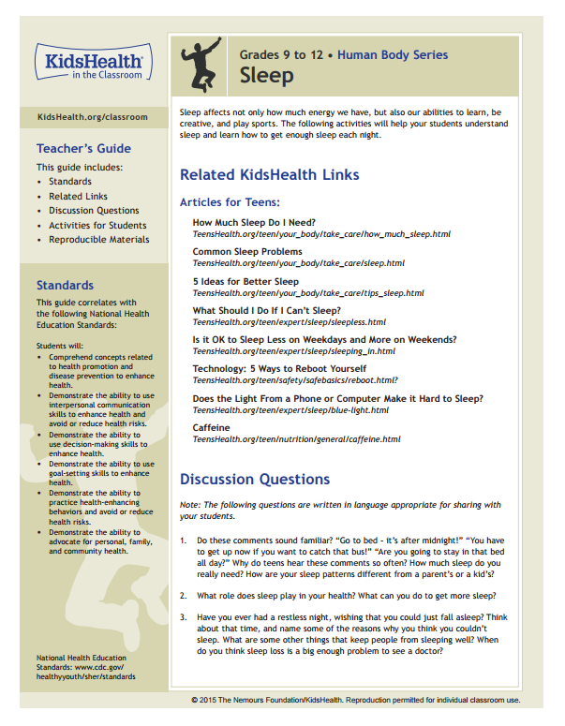
Nemours Grades 9-12 Curriculum
http://kidshealth.org/classroom/9to12/body/functions/sleep.pdf

Slide 53

American Academy of Sleep Medicine
K-12 Lesson Plans
http://www.school.sleepeducation.com/

Slide 54
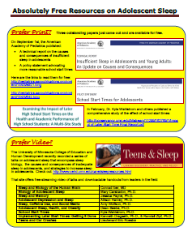

More resources, compiled by Ohio’s Dr. Dean Beebe:
http://www.ohioadolescenthealth.org/sleep-resources.html

Slide 55
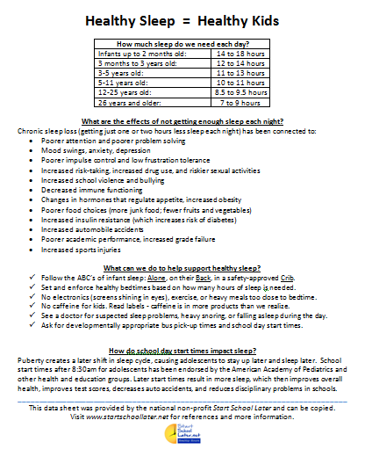
Free Handout from Start School Later
http://www.startschoollater.net/download-flyers.html

Slide 56
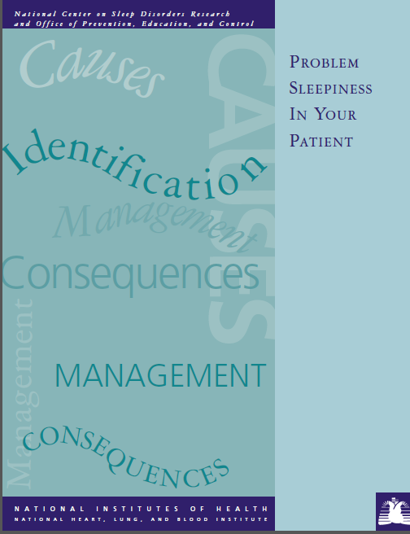
Free 9-page guide from NIH
http://www.nhlbi.nih.gov/health-pro/resources/sleep/problem-sleepiness

Slide 57
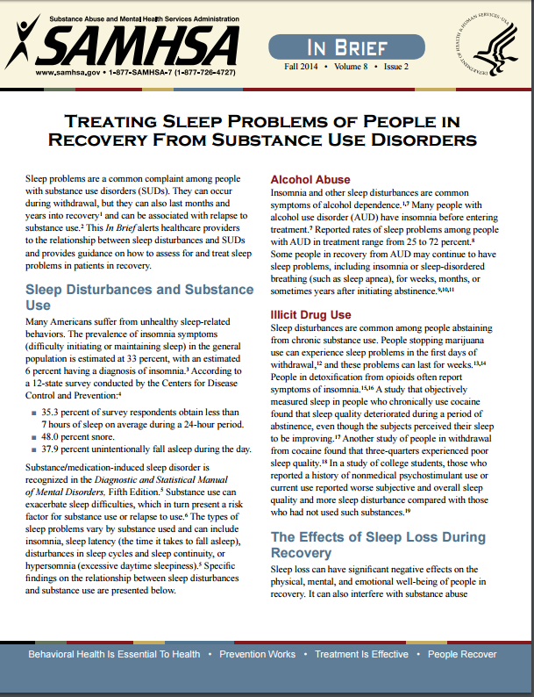
Free 4-page resource from SAMHSA
http://store.samhsa.gov/product/Treating-Sleep-Problems-of-People-in-Recovery-From-Substance-Use-Disorders/SMA14-4859

Slide 58
Barriers to Sleep for Adolescents
Lack of Awareness
Evening Stimulation
Early Wake Times

Slide 59


Evening Stimulation
TV
Video Games
Studying/Heavy Reading
Bright or Flickering Light
Exercise, sports practices
(ideally not within 2-3 hrs of bedtime)
Caffeine
(teach parents and teens to read labels)

Slide 60
Barriers to Sleep for Adolescents
Lack of Awareness
Evening Stimulation
Early Wake Times

Slide 61
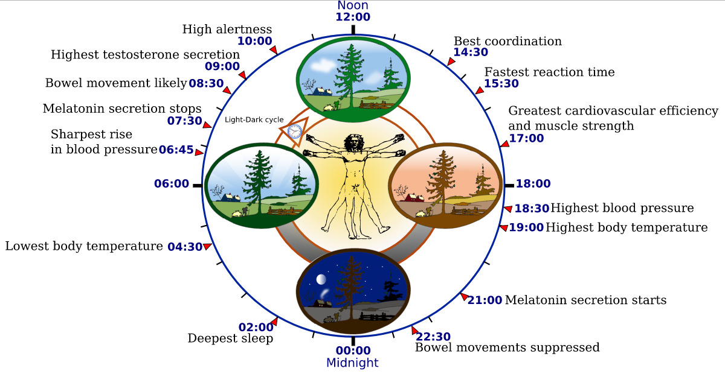
Why Are Adolescents
Sleep-Deprived?
Adolescent melatonin secretion stops 09:00
22:30 Adolescent melatonin
secretion starts

Slide 62











Later middle/high school start times:
National PTA
American Academy of Pediatrics
American Medical Association
Centers for Disease Control
National Assn of School Nurses
Society of Pediatric Nurses
American Thoracic Society
Education Commission of States
American Psychological Assn
American Sleep Association
American Physiological Association
National Education Association
Family Sleep Institute

Slide 63
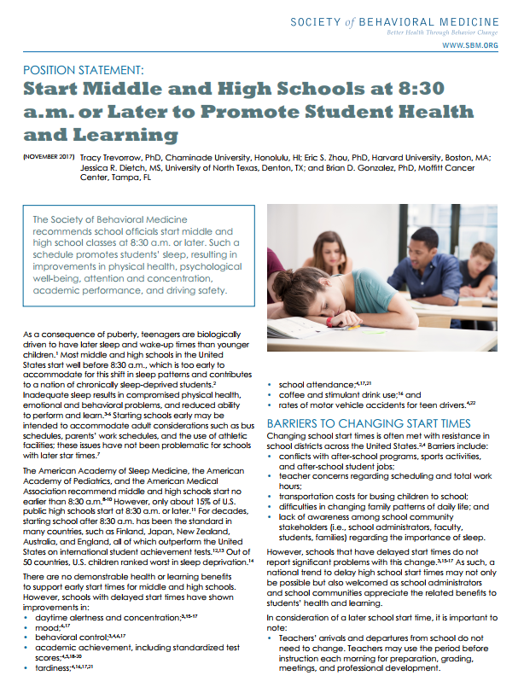
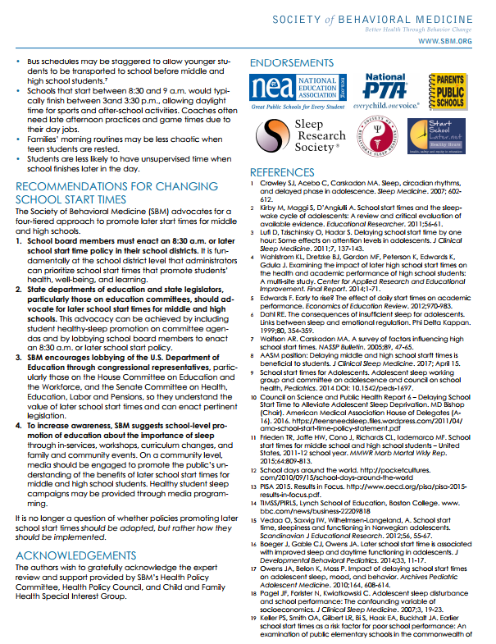
Society of Behavioral Medicine Recommendations:
School boards enact an 8:30 a.m. or later start times policy in their school districts.
2) State departments of education and state legislators should advocate for change.
3) Lobby the U.S. Dept of Education.
4) School-level promotion of education about the importance of sleep through in-services, workshops, curriculum changes, and family and community events.

Slide 64

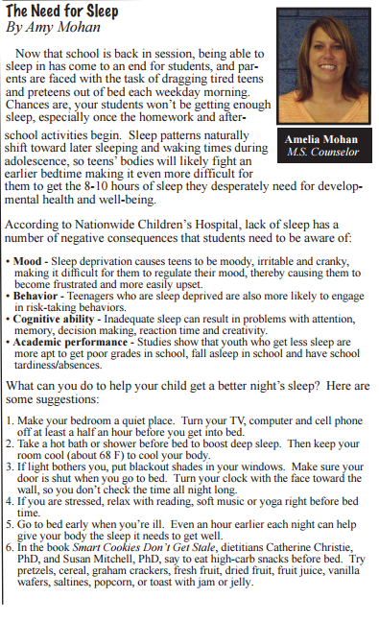
Newsletter example from NE Ohio…

Slide 65
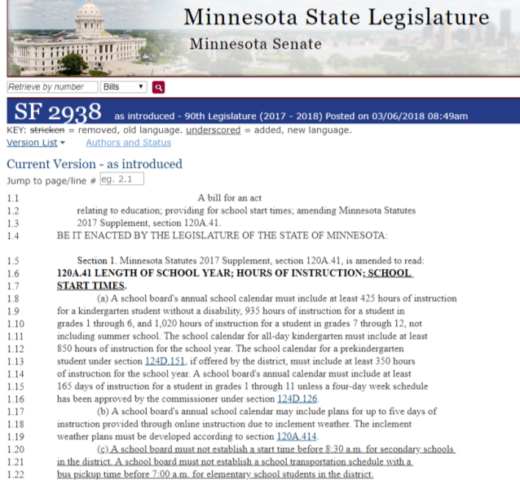
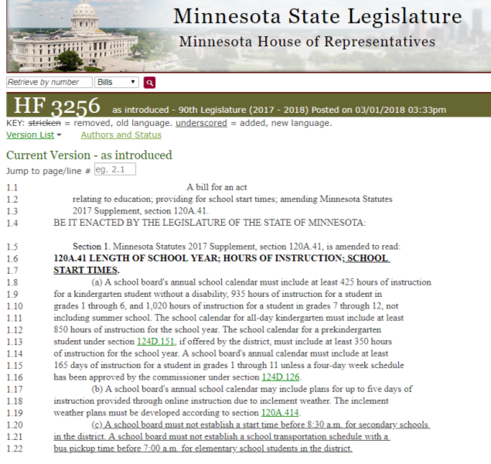

Secondary schools cannot start before 8:30 a.m.
Elementary bus pick ups cannot occur before 7 a.m.

Slide 66
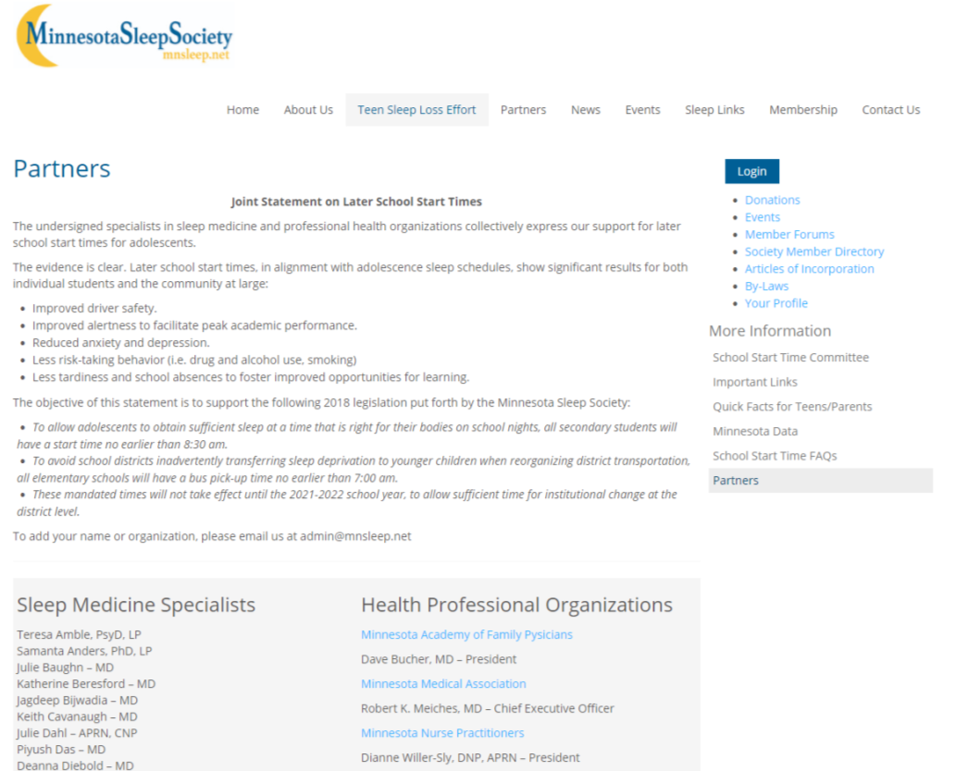
To register support as a professional:
www.mnsleep.net/school-start-time/partners

Slide 67


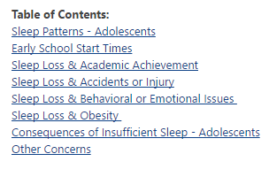
Research database available via www.StartSchoolLater.net

Slide 68

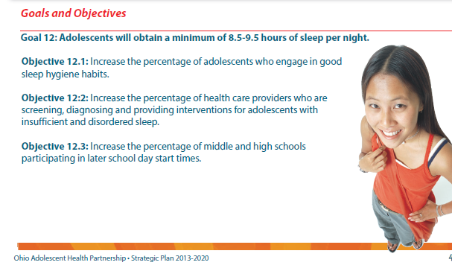
What can you do?
Educate
Screen/Treat/Refer
Advocate Locally/Statewide
www.OhioAdolescentHealth.org

